Slide 1
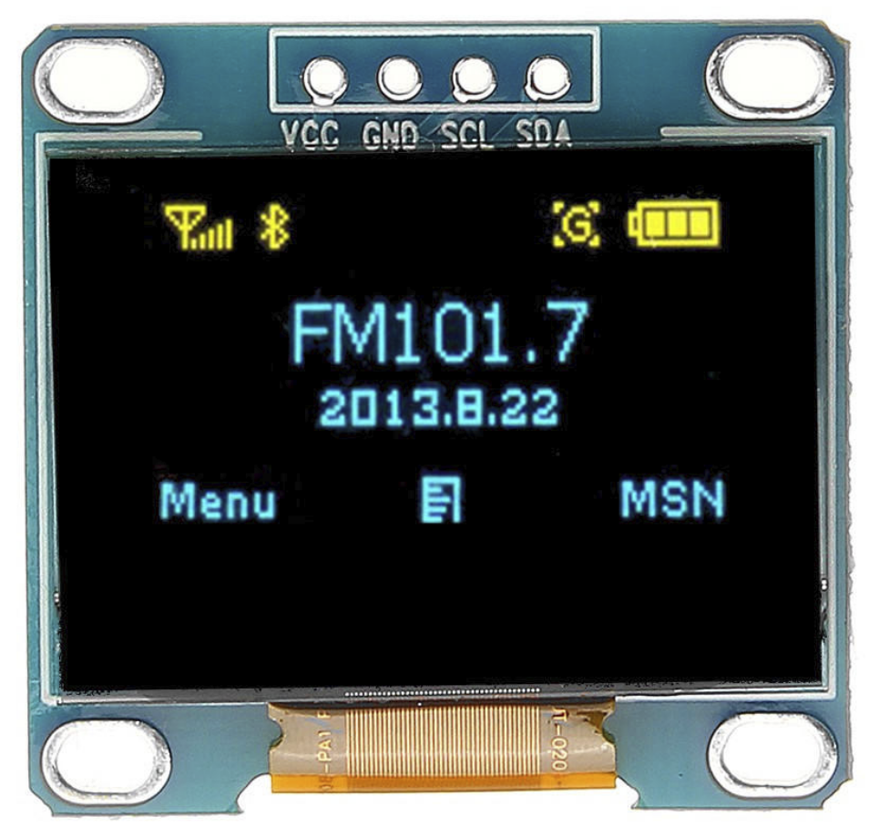
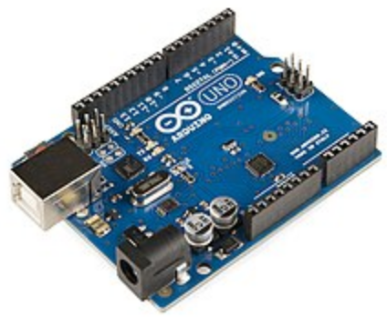
OLED

Slide 2
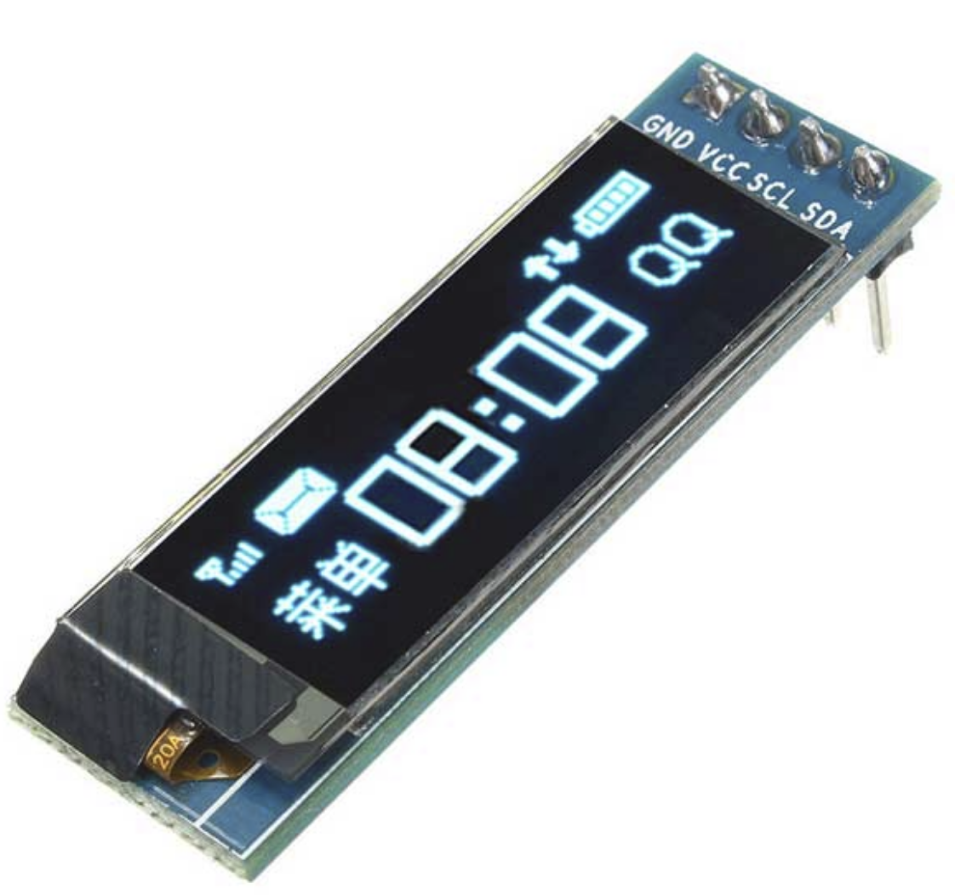
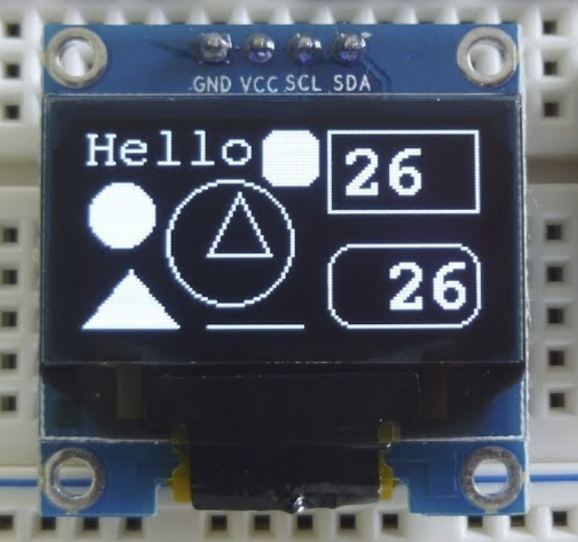
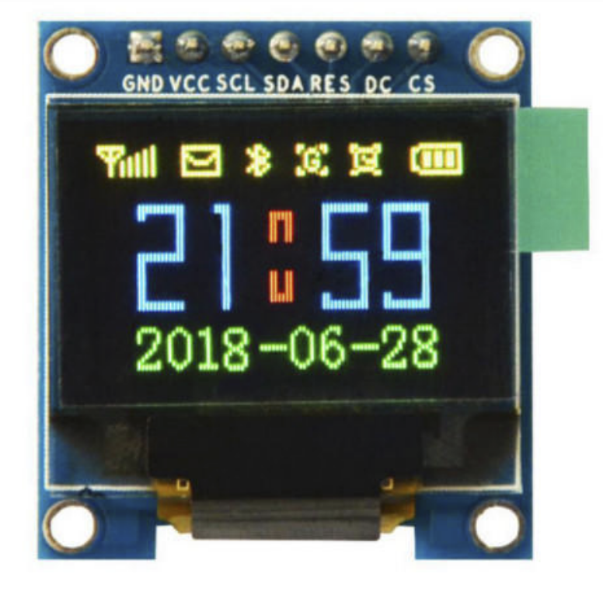
OLEDs
Organic Light Emitting Diode
Uses Organic molecules to emit light
Organic semiconductors discovered in mid 1970’s
First practical OLED developed by Kodak in 1987

Slide 3
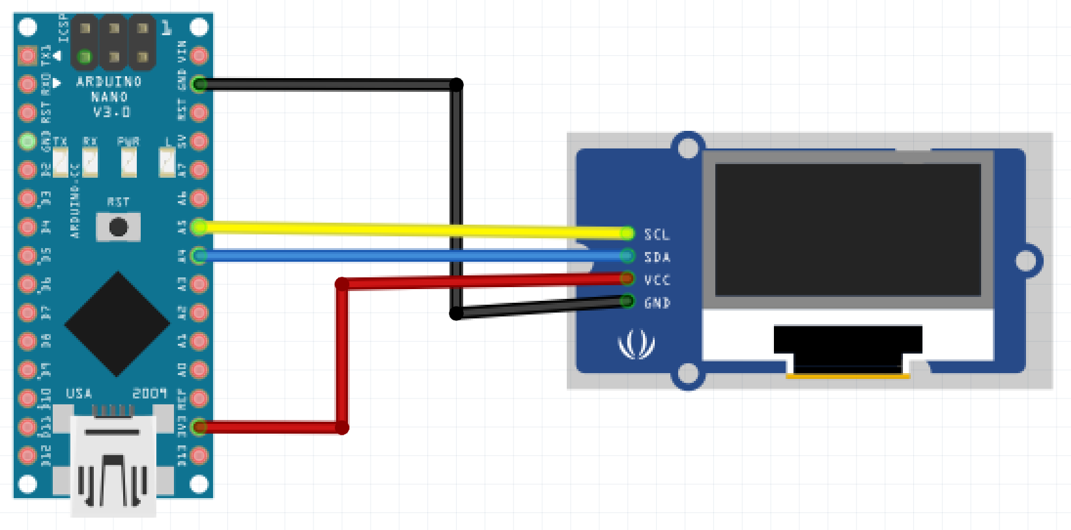
Setup: Wire
GND -> GND
VCC -> 3.3V
SCL -> A5
SDA -> A4

Slide 4
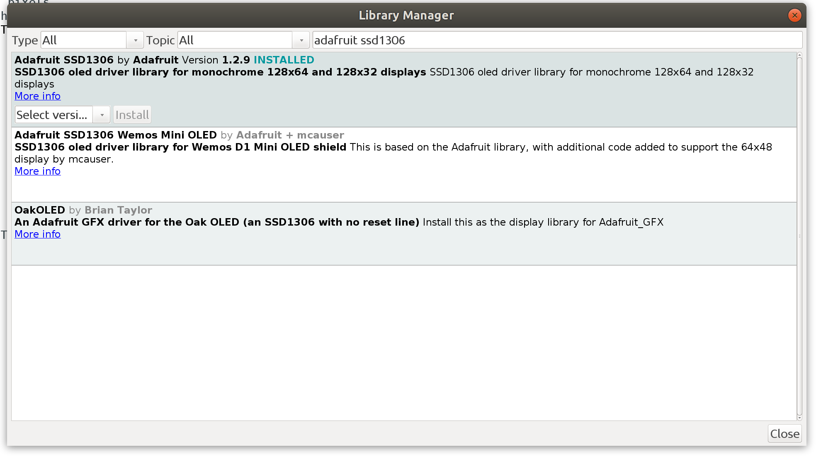
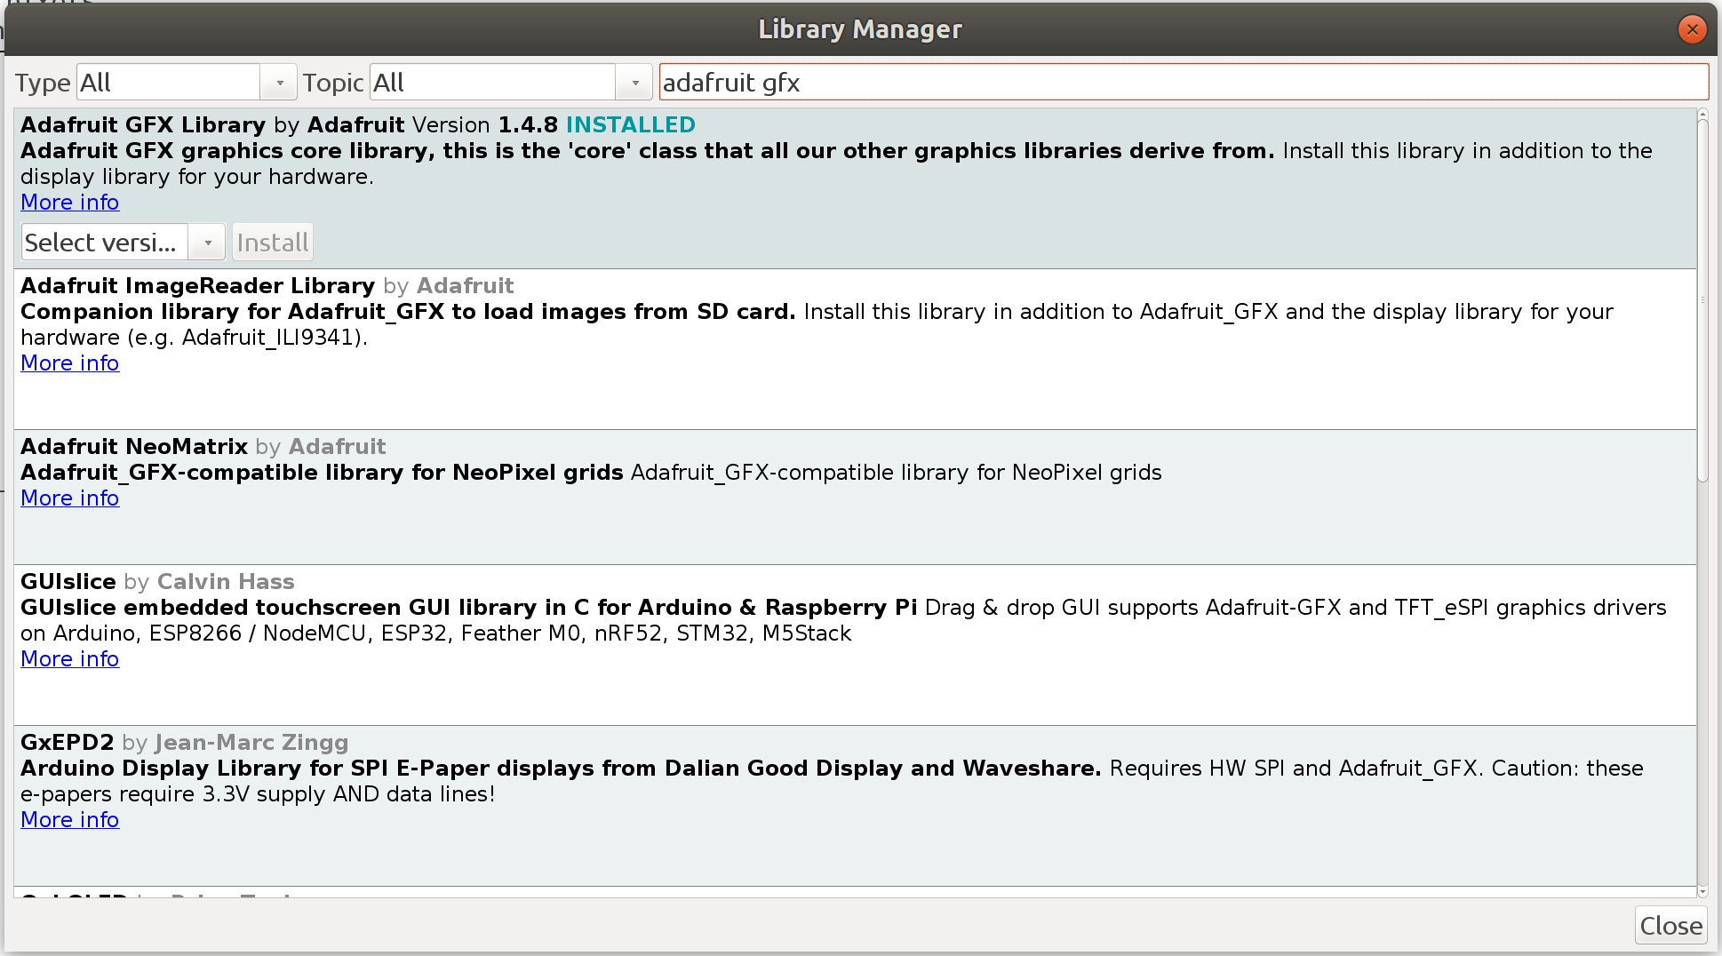
Setup: Library
Include Library:
Sketch -> Include Library -> Manage Libraries
Search for adafruit ssd1306 && adafruit gfx

Slide 5
Simple test
File -> Example -> Adafruit SSD1306 ->ssd1306_128x32_i2c
Burn the code into arduino see what happen.
Since we are using Yellow Blue OLED, the default color for top side is yellow, bottom is blue.

Slide 6
Simple test
File -> Example -> Adafruit SSD1306 ->ssd1306_128x32_i2c
Burn the code into arduino see what happen.
File -> Example -> Adafruit SSD1306 ->ssd1306_128x64_i2c
what is difference?
Since we are using Yellow Blue OLED, the default color for top side is yellow, bottom is blue.

Slide 7
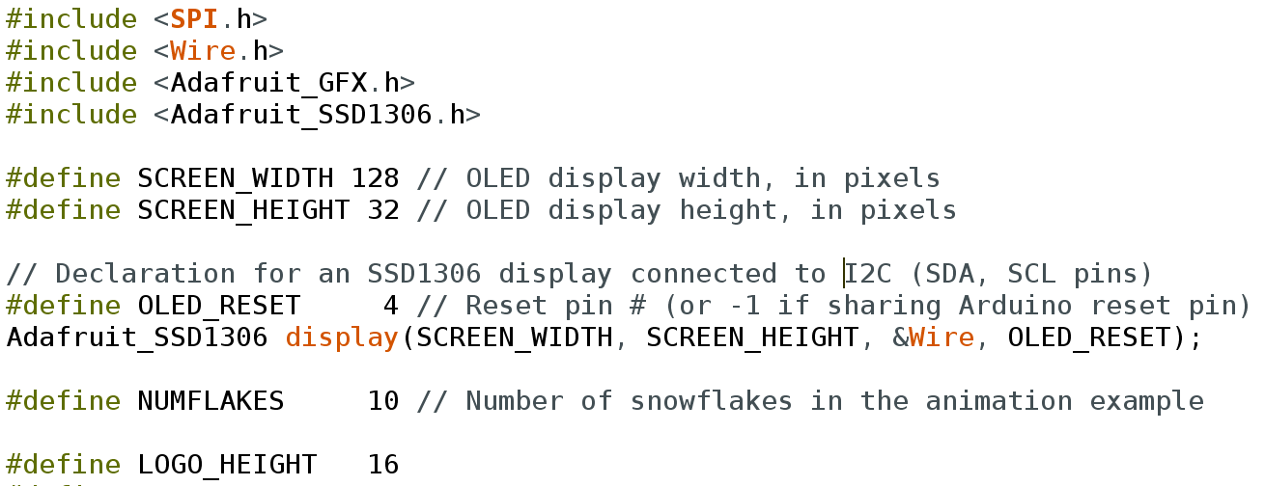
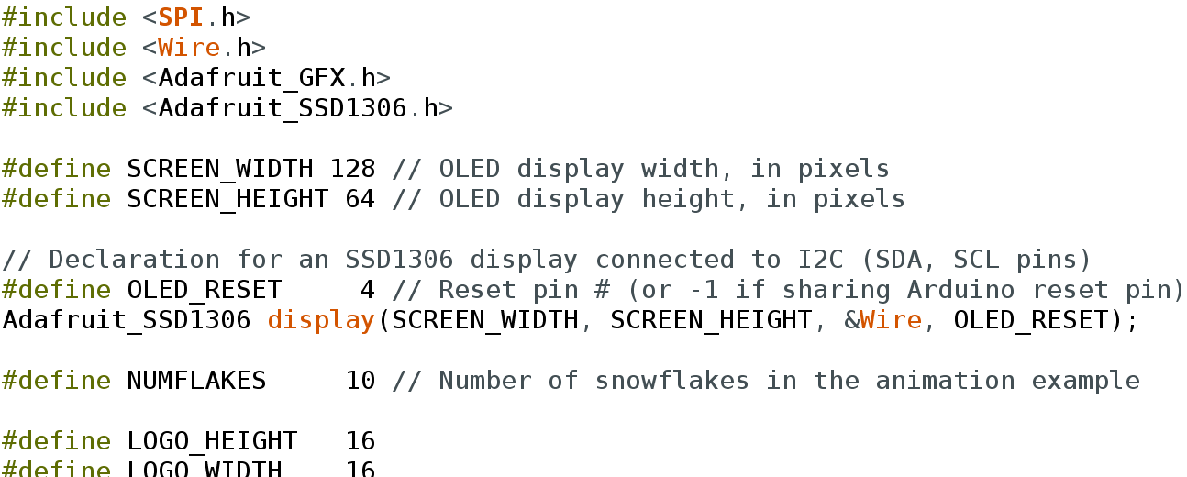
Difference between 32 and 64
In 128x32: In 128x64:

Slide 8
Key Functions
Adafruit_SSD1306 display(SCREEN_WIDTH, SCREEN_HEIGHT, &Wire, OLED_RESET); //Init OLED screen
display.begin(SSD1306_SWITCHCAPVCC, 0x3C); //Assign I2C address to OLED
display.clearDisplay(); //clear whatever is been draw on screen before.
----------------------------------
display.setTextColor(WHITE); // WHITE means display, BLACK will hide it.
display.setCursor(30,32); // set the position where you want the text to begin (x,y)
display.setTextSize(1); //set text size
display.print("I love Robot"); // set text
display.drawRect(112, 0, 14, 6, WHITE); // draw a rect on screen (start X, start Y, wide of rect, height, display)
//Every function inside here are write into buffer, NOT to Screen
-----------------------------------
display.display(); //write buffer into screen and display

Slide 9
Custom drawing
const unsigned char bluetooth [] PROGMEM = {
0x00, 0x00, 0x0c, 0x00, 0x0e, 0x00, 0x3e, 0x00, 0x1c, 0x00, 0x0c, 0x00, 0x3e, 0x00, 0x0e, 0x00,
0x0c, 0x00, 0x00, 0x00
};
//custom drawing picture in bitmap
//0x00 means empty, any other variable means color.
display.drawBitmap(0,0, bluetooth, 10,10,1);
// draw custom picture on screen (start X, start Y, bitmap, width, height, display)

Slide 10
How to draw a bitmap
Draw your favorite picture in black and white;
Save as BMP picture.
(windows: “Paint” have build in function for save as BMP)
Go to this website:http://javl.github.io/image2cpp/ to transfer your picture to bitmap

